Slide 1
Introductory General Chemistry
Chemistry 3A
S. M. Halloran

Slide 2
This Slide Set: Book Chapter 4
Matter: Properties and Changes Affecting It
Compounds
Molecules As Polyatomic Forms of The Elements
Ionic Compounds
Chemistry Nomenclature: Naming of Compounds

Slide 3
Matter: Properties and Changes Affecting It
Physical Property
a characteristic of a substance that can be observed or measured without changing the identity of the substance
Color | Electrical conductivity
Hardness | Density
Malleability (ability to be hammered) | Melting point
Solubility | Boiling point

Slide 4
Matter: Properties and Changes Affecting It
Chemical Property
potential to undergo some chemical change or reaction by virtue of its composition
Metals like Zn (zinc) reacting with acid
Forming oxides in reacting with oxygen
This involves substance changing into another substance

Slide 5
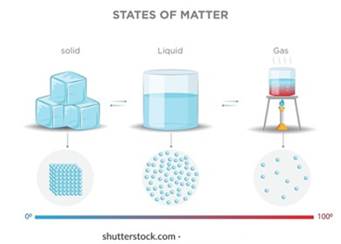
Physical (State) Changes
States of matter are solid, liquid, gas
Changes in the states of matters are:
Vaporization
Liquid to gas
Freezing
Liquid to solid
Condensation
Gas to liquid

Slide 6
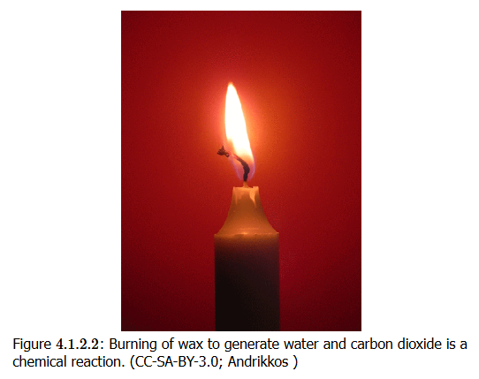
Chemical Changes

Slide 7
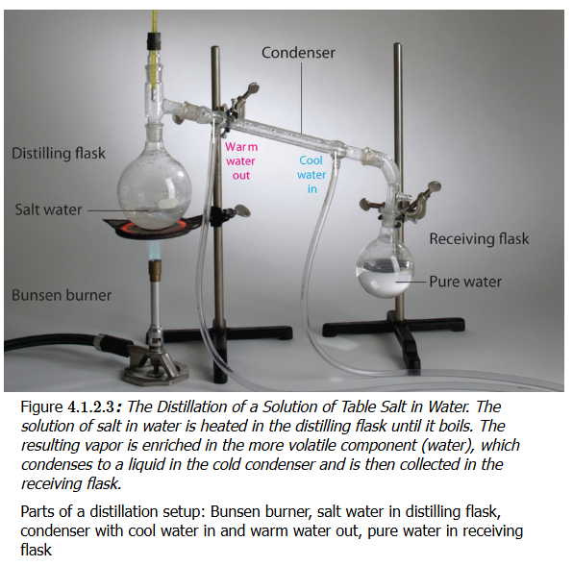
Making Use of Physical Properties
Distillation
Separating/purifying compounds based on boiling point
Precipitation
Separating/purifying compounds based on solubility
Some stay in solution,
Others come out of solution
Filtration
Separating compounds

Slide 8
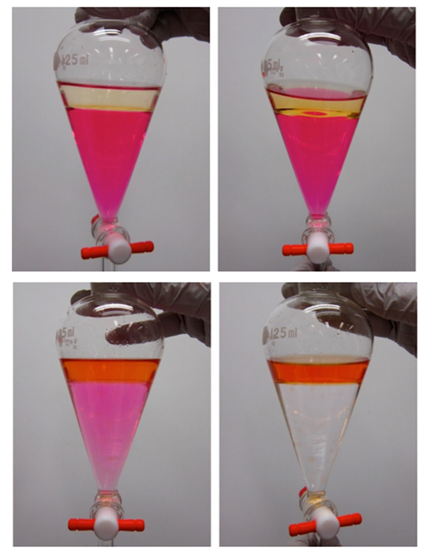
Making Use of Physical Properties
Solvent Extraction
Separating/purifying compounds based on preference (“partition”) for organic vs aqueous solvents
Chromatography
Separating/purifying compounds based on same principle as solvent extraction but with flowing (mobile) vs non-flowing (stationary) phases

Slide 9
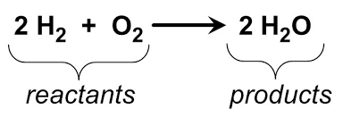
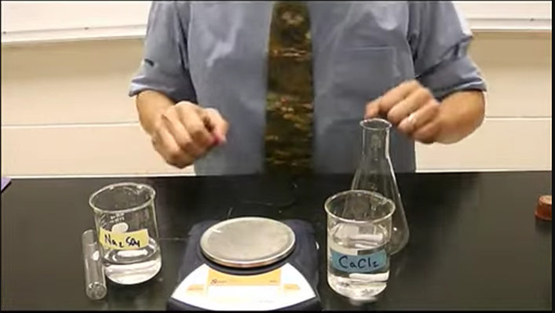
LAW of Conservation of Mass
1789 French chemist Lavoisier
Matter cannot be created or destroyed
Chemical reaction: mass of reactants and mass of products identical
https://www.youtube.com/watch?v=Wwmsy4huZQ0

Slide 10
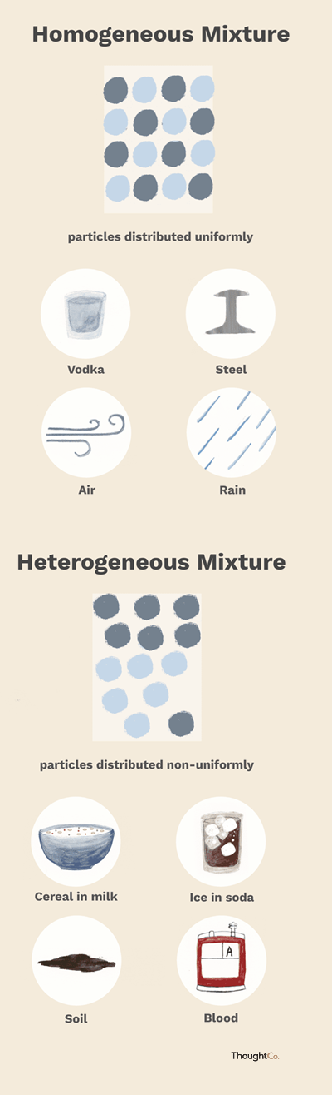
Mixtures
Multiple phases may be present
Components are not evenly distributed
You can often see or separate the parts
Homogeneous
one in which the composition is uniform throughout. You can’t see the individual components, and every sample taken from the mixture will have the same properties
Appears as a single phase (solid, liquid, or gas)
Evenly distributed particles
Cannot distinguish components by eye
Heterogeneous
has a non-uniform composition
The different parts of the mixture are visibly distinct, and samples taken from different areas may have different properties
Multiple phases may be present
Components are not evenly distributed
You can often see or separate the parts

Slide 11
Compounds
A compound is a substance that contains two or more elements chemically combined in a fixed proportion
CH₄ (methane)
One carbon atom
Four hydrogen atoms
Unlike mixtures, cannot be separated by physical means
Can be “decomposed” by chemical changes CH₄ (g) + 2 O₂ (g) → CO₂ (g) + 2 H₂O (g)

Slide 12
Compounds: Chemical Formula
A chemical formula is a way of presenting information about the relative chemical proportions of atoms that constitute a particular compound or molecule
H₂O
H₂SO₄
Ca₃(PO₄)₂

Slide 13
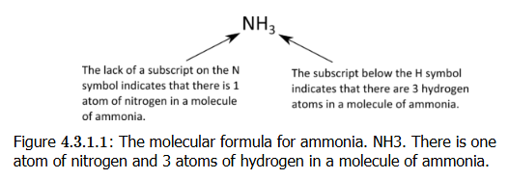
Compounds: Molecular Formula
A molecular formula is a chemical formula gives number of atoms of each of the elements present in one molecule of a specific compound
It is composed of element symbols for the atoms and subscripts to indicate count of the atoms. If there is only one atom in the compound, a subscripted “1” is omitted

Slide 14
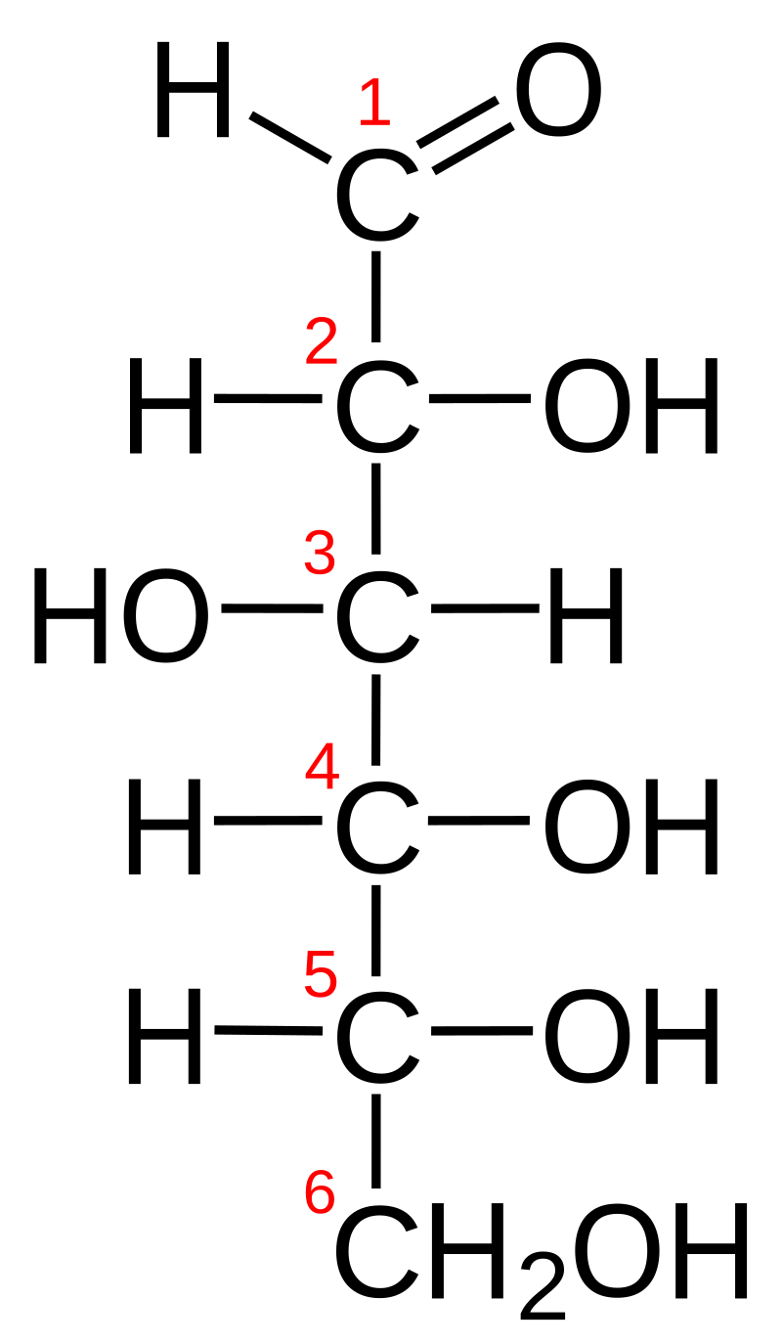
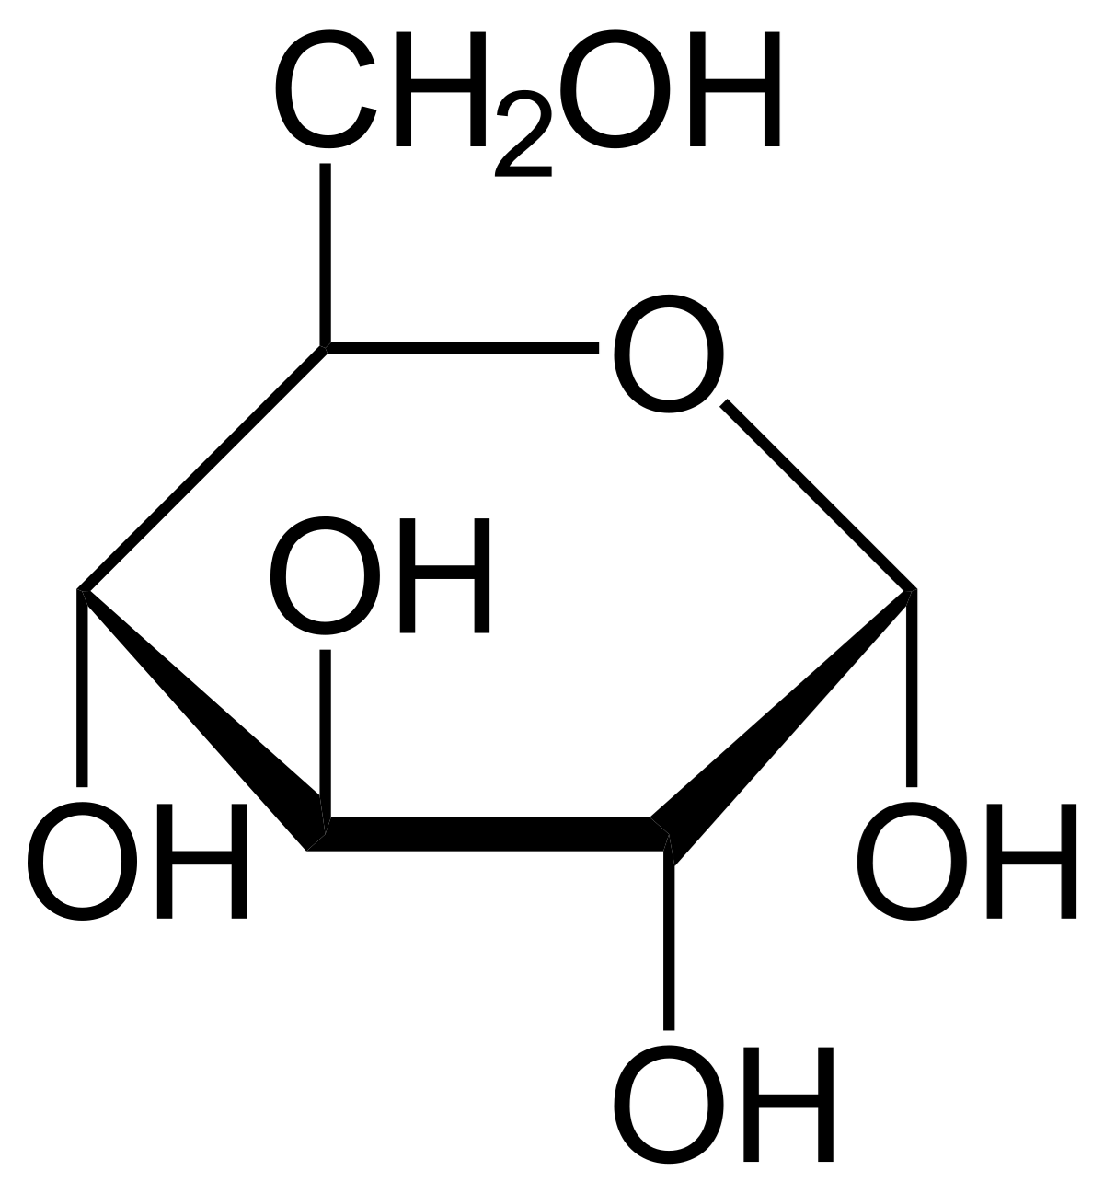
Compounds: Empirical Formula
An empirical formula is a chemical formula that shows the elements in a compound in their lowest whole-number ratio
Glucose has a molecular formula of C₆H₁₂O₆
But glucose has an empirical formula of CH₂O
Why? Because when chemists first start to analyze & characterize an unknown compound, they find glucose has 1 part carbon, 1 part oxygen, 2 parts hydrogen
NOTE THIS: in some cases the empirical formula and molecular formula are the same!!

Slide 15
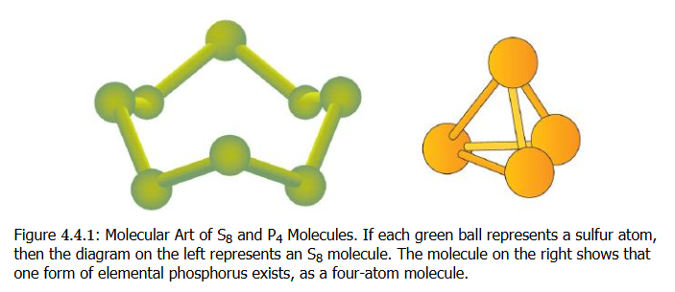
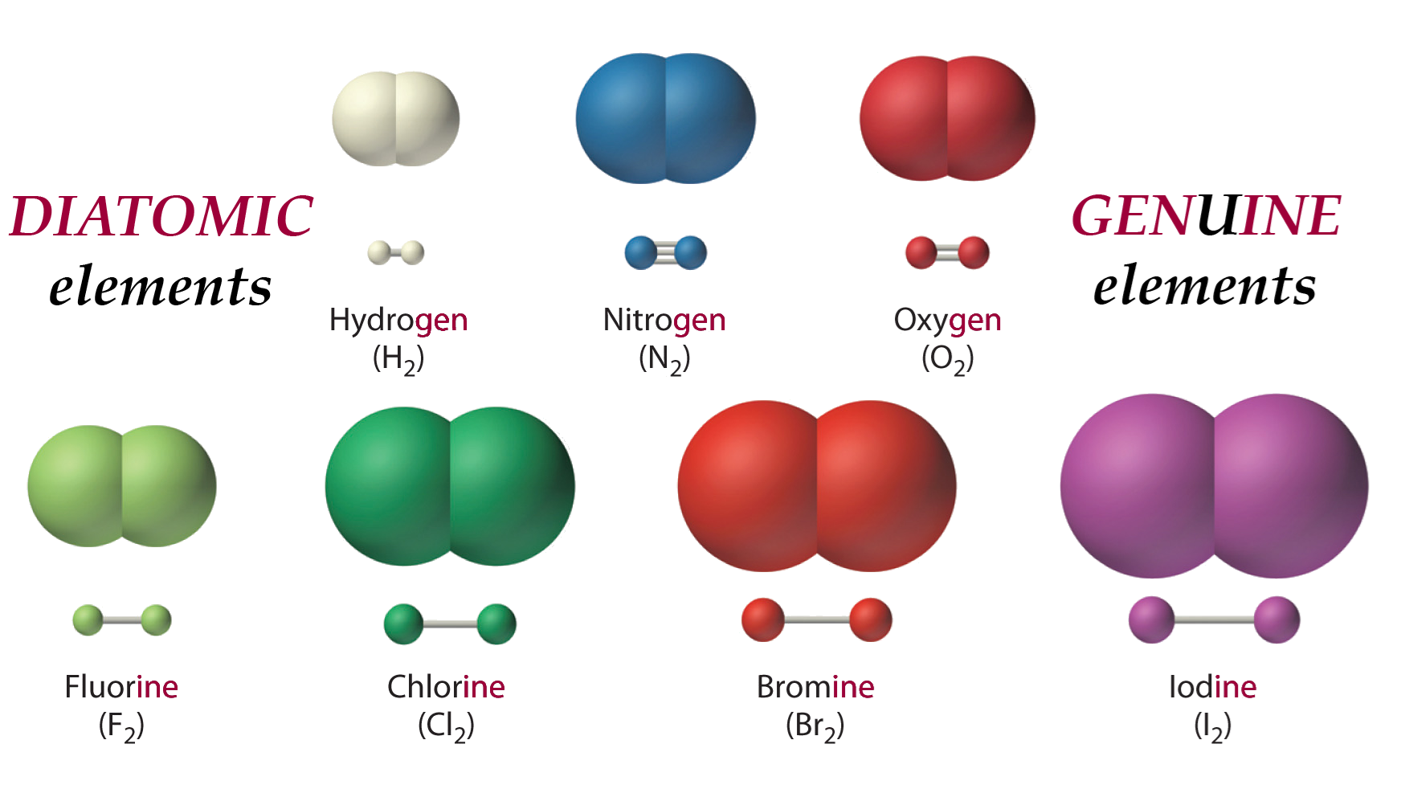
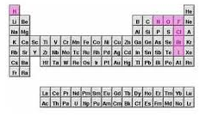
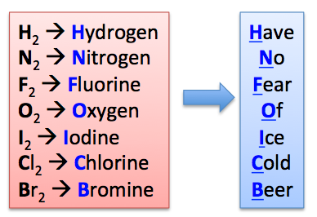
Atomic Elements, Molecular Elements
Elements that exist as their individual atoms in nature are called atomic elements
Some elements do not exist in nature as individual atoms, but bonded with each other. These are molecular elements
Molecular elements can form often diatomic molecules or polyatomic molecules

Slide 16
Formula Unit
“The formula unit is the basic unit of ionic compounds”
Also: “in chemistry, a formula unit is the smallest unit of a non-molecular substance, such as an ionic compound, covalent network solid, or metal
Something that does form a discrete molecule, something not forming a molecular compound
NaCl, CaF₂, ZnBr₂ are the three formula units of these ionic compounds

Slide 17
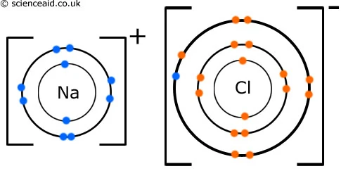
Ionic Compounds
Ionic compounds form when atoms BOND with each other based on one atom have a positive charge and the other having a negative charge
A sodium (Na) atom easily gives up the ONE electron (all for energetic stability) which is its ONE valence shell electron to a chlorine (Cl) atom which has SEVEN valence shell electrons and wants a more stable complete valence shell of EIGHT electrons. The electron transfer creates an IONIC bond and Na and Cl will form an ionic compound as a result

Slide 18
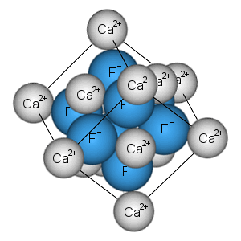
Ionic Compounds
Generally metal elements will form ionic compounds with nonmetal elements in the correct ratios
Metals will give up electrons and nonmetals as a rule to form these ionic compounds (with lots of exceptions to the rule)

Slide 19
Ionic Compounds
Ionic compounds will dissolve in water to form individual ions that move about
When they form crystal solids, they exist in a lattice with an ordered structure in the correct ratio of atoms of the formula unit in the solid state
The ratio of atoms in the formula unit should have a zero net charge
Aluminum nitride
aluminum ion has 3+ charge: Al³⁺
nitride ion has a 3- charge: N³⁻
One Al³⁺ combines with one N³⁻ → Al₁N₁
Final formula: AlN (leave out 1s if in subscript)

Slide 20
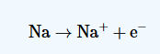
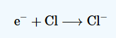
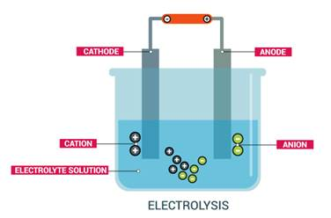
Cations and Anions
We talked about this is a previous lecture
cations “move to” the cathode
anions “move to” the anode
Cations are positively charged ions
Na⁺, K⁺, Ca²⁺, Li⁺
Anions are negatively charged ions
Cl⁻, Br⁻, OH⁻
Cathode is negatively charged pole
Anode is positively charged pole

Slide 21
Stock System
Part of the naming system for compounds
Formula | Old naming | Stock System | Ion
CuCl | cuprous chloride | copper(I) chloride | Cu⁺
CuCl₂ | cupric chloride | copper(II) chloride | Cu²⁺
FeCl₂ | ferrous chloride | iron(II) chloride | Fe²⁺
FeCl₃ | ferric chloride | iron(III) chloride | Fe³⁺

Slide 22
Criss-Cross Method
If you are trying to figure out number of atoms in a formula unit or molecule where the cations and anions have different charge magnitudes, this method helps
Formulas for ionic compounds regarded as empirical formulas: use lowest ratio
lead (IV) oxide
What is cation and anion? | Pb⁴⁺, O²⁻
Exchange charge magnitudes to be subscripts on other atoms | Pb₂O₄
Find “greatest common divisor” → 2 | PbO₂

Slide 23
Criss-Cross Method (more)
calcium oxide
copper(I) sulfide
What is cation and anion? | Ca²⁺, O²⁻
Exchange charge magnitudes to be subscripts on other atoms | Ca₂O₂
Find “greatest common divisor” → 2 | CaO
What is cation and anion? | Cu⁺, S²⁻
Exchange charge magnitudes to be subscripts on other atoms | Cu₂S₁
Nothing to divide | Cu₂S

Slide 24
Polyatomic Ions
In previous slides, we saw cations/anions as single elements
Here the anion is polyatomic. The method still applies. Note how parentheses are placed around the polyatomic (an)ion to treat it as an ionic group
calcium nitrate
What is cation and anion? | Ca²⁺, NO₃⁻
Exchange charge magnitudes to be subscripts on other atoms | Ca₁(NO₃)₂
Nothing to divide | Ca(NO₃)₂

Slide 25
Polyatomic Ions
potassium sulfate
In the calcium nitrate, we have TWO nitrates, so we had to use parentheses in final formula to show the group and add the subscript 2
If there is only 1 polyatomic ion group, we don’t need parentheses
What is cation and anion? | K⁺, SO₄²⁻
Exchange charge magnitudes to be subscripts on other atoms | K₂(SO₄)₁
Nothing to divide | K₂SO₄

Slide 26
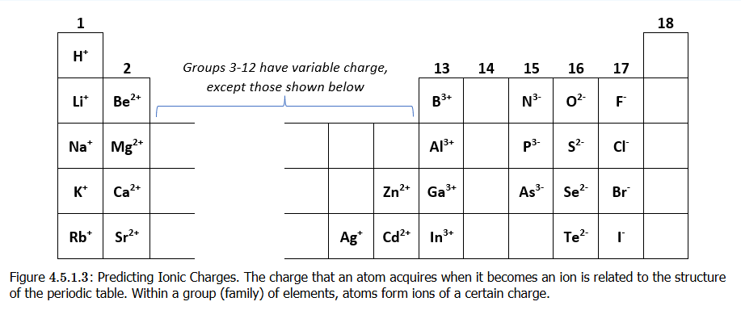
Predicting Cation or Anion
Table group and number of electrons in valence shell are connected: Group 1 – 1 valence electron, Group 2 – 2 valence electrons, and so on
This helps you predict whether an atom wants to get rid of acquire electrons!

Slide 27
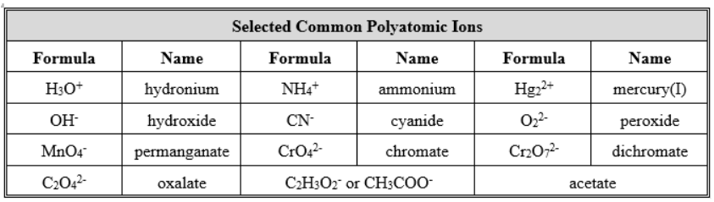
Polyatomic Ions
Ions not necessarily a charge on a single atom of an element
They can be a group of atoms bonded together that form natural (stable) ions

Slide 28
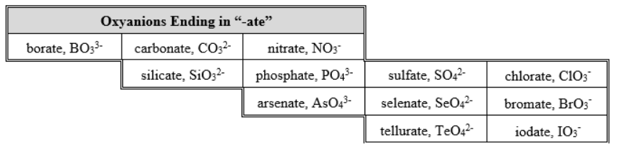
Polyatomic Ions

Slide 29
Ionic or Not Ionic?
Is the cation a metal and anion a nonmetal?
Likely ionic
Are all the atoms in the molecule/compound nonmetallic elements?
Likely not ionic
Is there a polyatomic group that you recognize as ionic?
Ammonium (NH₄⁺) cation
Nitrate (NO₃⁻) anion

Slide 30
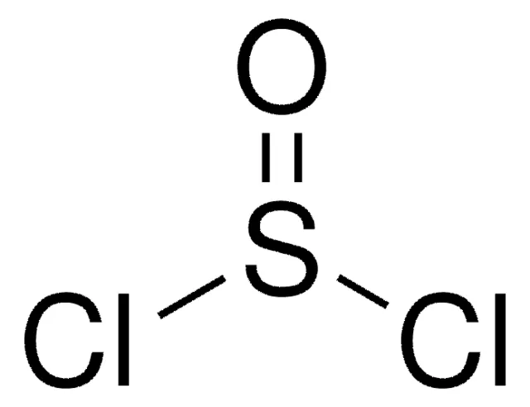
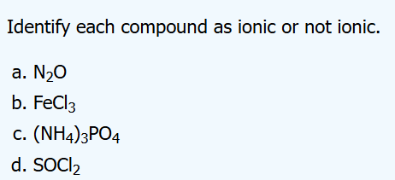
Ionic or Not Ionic?
A) nitrogen (N) and oxygen (O) atoms nonmetals: not ionic B) iron (Fe) = metal, chlorine (Cl) = nonmetal: ionic
C) ammonium (NH₄) = recognized polyatomic cation, phosphate (PO₄) = recognized polyatomic anion ionic
D) S, O, and Cl are all non-metals, and no recognized polyatomic ions seen not ionic
Thionyl chloride (structure above) is used in organic chemistry to chlorinate compounds

Slide 31
Polyatomic vs Molecular Ion
Extra stuff: no need to memorize
When atoms are bonded together, that looks like a molecule, right?
But chemists have a certain terminology here when it comes to polyatomic vs molecular ions
Methane (CH₄) is normally not an ionized molecule. But it can be if one uses high energy to knock an electron out. This is an unstable ion formation
In polyatomic ions, these are ionized as part of a stable state, and they remained ionized

Slide 32
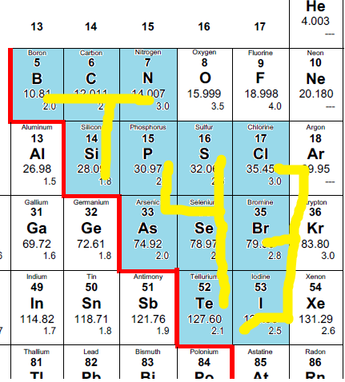
T43 Method
T: B, C, N, Si
4: P, S, As, Se, Te
3: Cl, Br, I
Oxygens:
4: PO₄, SO₄, AsO₄, SeO₄, TeO₄
3: ClO₃, BrO₃, IO₃
T: BO₃, CO₃, NO₃, SiO₃
Charged:
3-> (-1): ClO₃⁻, BrO₃⁻, IO₃⁻
4-> (-2): PO₄²⁻, SO₄²⁻, AsO₄²⁻, SeO₄²⁻, TeO₄²⁻
T: BO₃³⁻, CO₃²⁻, SiO₃²⁻, NO₃¹⁻ (start from N [1-], then C and Si [both 2-], then B [3-])

Slide 33
Chemistry Nomenclature: Naming of Compounds
Some history Lavoisier (1787) publishes “New Chemical Nomenclature”
Now done by IUPAC International Union of Pure and Applied Chemists The Red Book
https://iupac.org/what-we-do/books/redbook/

Slide 34
Chemistry Nomenclature: Naming of Compounds
Ionic compounds
Type I cations: charge does not vary
directly use element name
Na⁺ ➔ “sodium” Al³⁺ ➔ “aluminum”

Slide 35
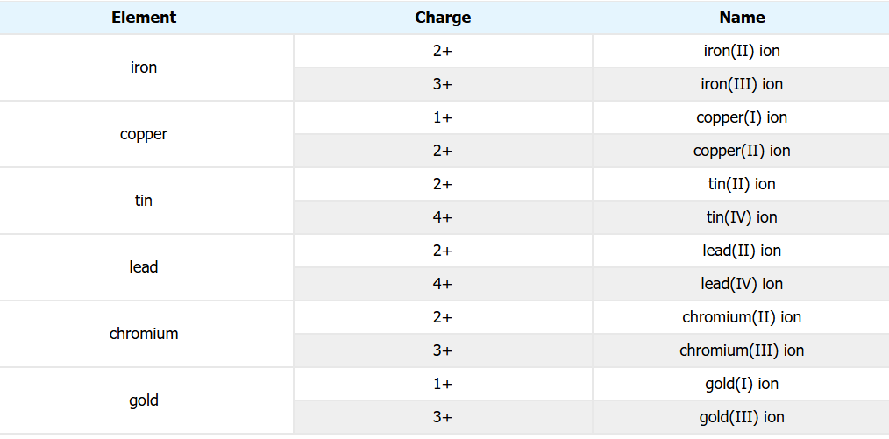
Chemistry Nomenclature: Naming of Compounds
Ionic compounds
Type II cations: charge of element will vary use the Stock system

Slide 36
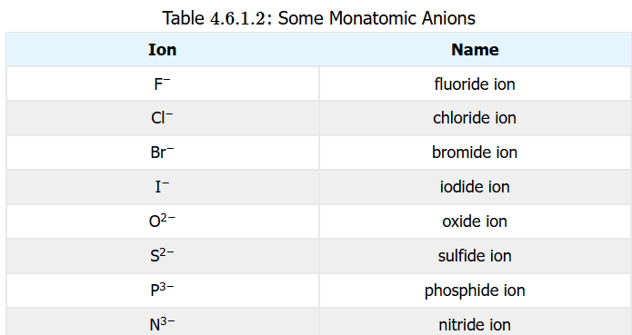
Chemistry Nomenclature: Naming of Compounds
Ionic compounds
Monoatomic Anions

Slide 37
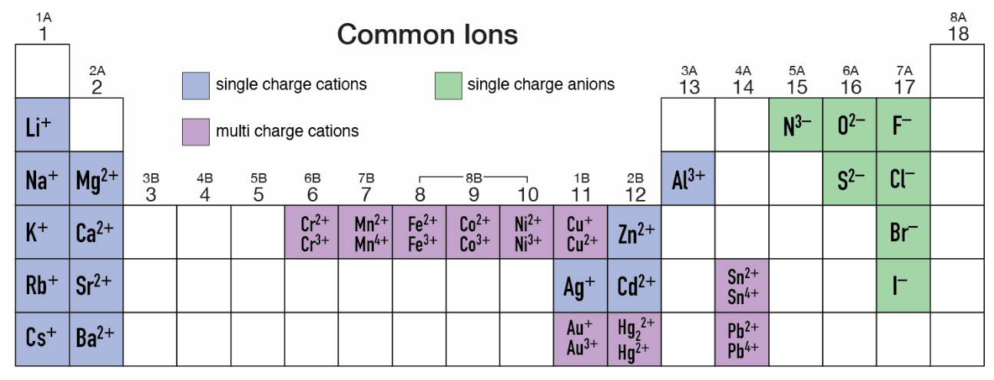
Charge States of Common Ions
The single charge cations are Type I cations and include Gallium in Group 13 (not shown) [Indium is not a Type I cation]
The Type II cations are numerous and include many more

Slide 38
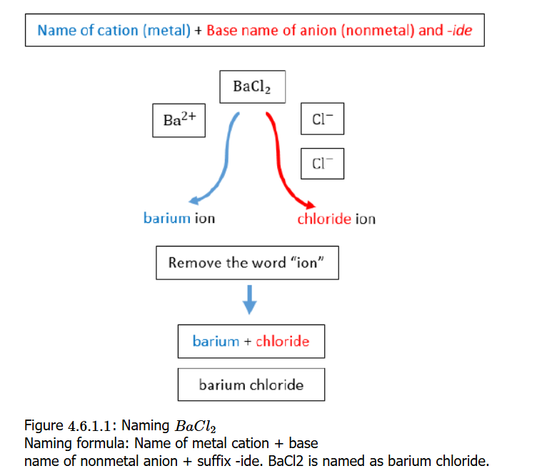
Chemistry Nomenclature: Naming of Compounds
Binary ionic compounds
Combine Type I monoatomic cation name with monoatomic anion

Slide 39
Chemistry Nomenclature: Naming of Compounds
Binary ionic compounds
Combine Type I monoatomic cation name with monoatomic anion

Slide 40
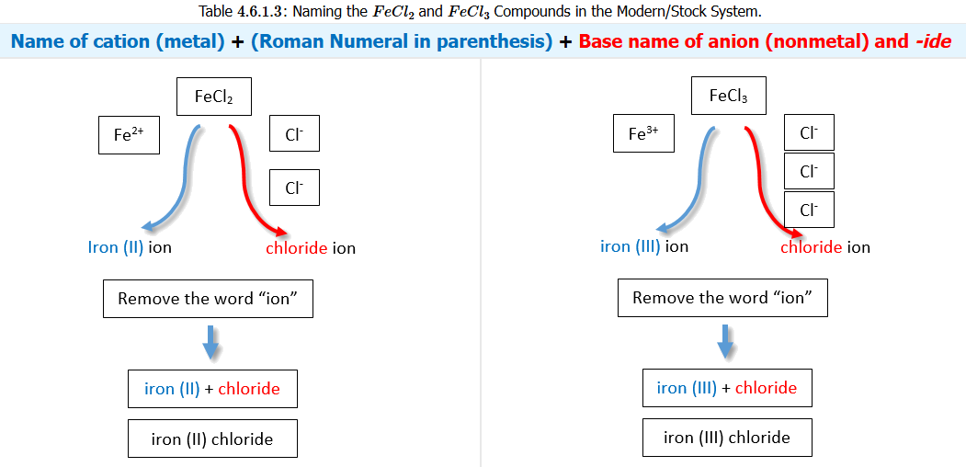
Chemistry Nomenclature: Naming of Compounds
Combine Type II cation name using Stock roman numerals with the anion name

Slide 41
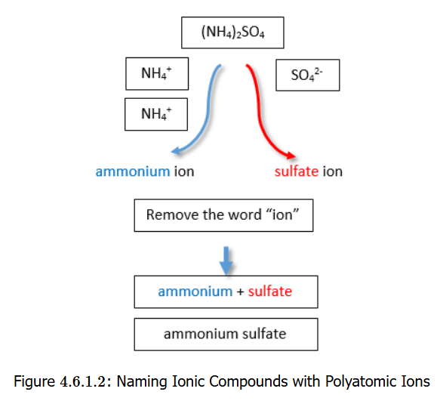
Chemistry Nomenclature: Naming of Compounds
Combine polyatomic cation names with polyatomic anion names

Slide 42
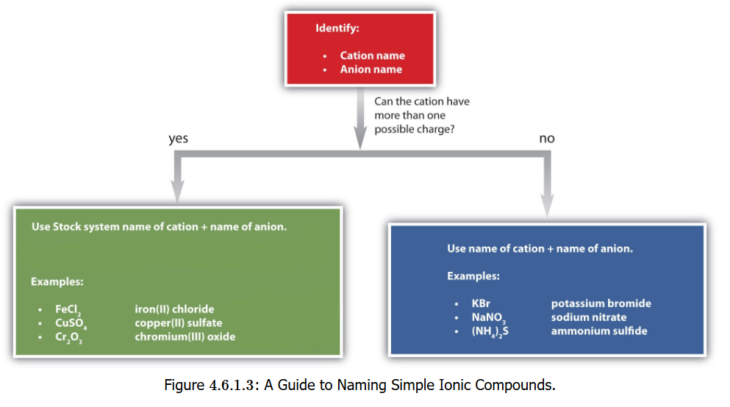
Chemistry Nomenclature: Naming of Compounds
Flowchart

Slide 43
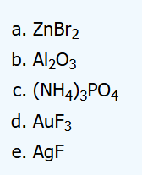
Chemistry Nomenclature: Naming of Compounds
Zn = zinc, Br = bromine → bromide
Zn has only one ion (Zn²⁺)
“zinc bromide”
Al = aluminum, O = oxygen → oxide
Al has only one ion (Al³⁺)
“aluminum oxide”
NH₄⁺ = ammonium, PO₄ = phosphate
Only one charge state for each
“ammonium phosphate” (not “triammonium phosphate”)
Au = gold, F = fluorine → fluoride
Gold has multiple charge states
“gold(III) fluoride”
Ag = silver, F = fluorine → fluoride
Ag has only one ion (Ag⁺)
“silver fluoride”

Slide 44
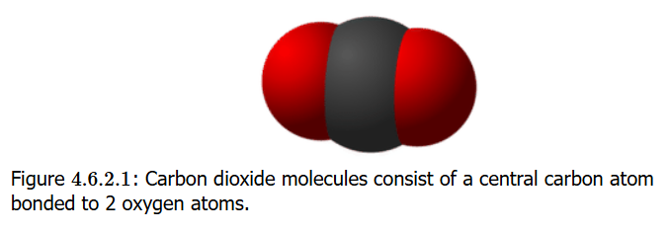
Molecular Compound Naming
Molecular compounds are inorganic compounds that take form of discrete molecules
The bonds are shared between atoms (not ionic)
Shared bonds are covalent bonds
In carbon dioxide, the bond between the central carbon and two oxygen atoms on either side are shared (no “ionic character”)

Slide 45
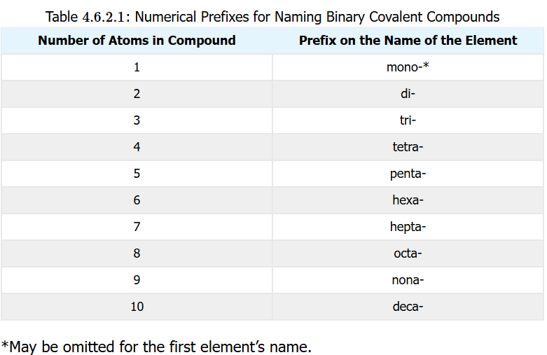
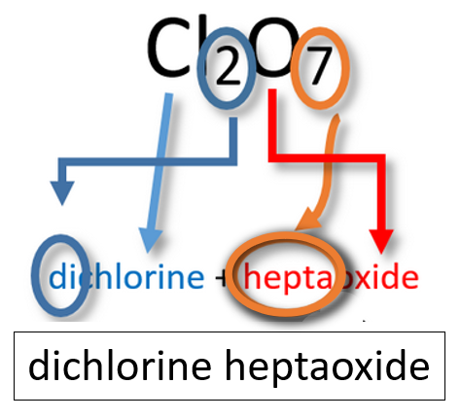
Molecular Compound Naming
Binary Molecular Compounds
1st element: name of element
2nd element: stem of element name + -ide
Prefixes: apply numerical prefixes to both elements

Slide 46
Molecular Compound Naming
Common Name Compounds
A systematic name not really used
H₂O: water
NH₃: ammonia
CH₄: methane
H₂O₂: hydrogen peroxide

Slide 47
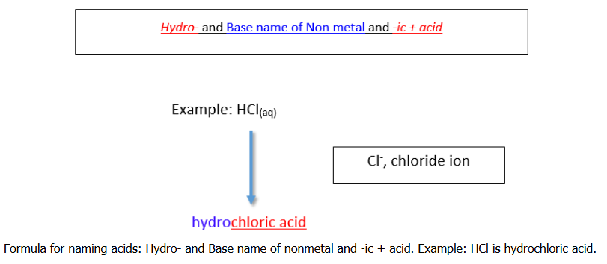
Acid Naming: Binary Acids
All acids contain hydrogen: the H⁺ ion, which is just a proton!, is what makes (protic) acids acids.
Acids put in water release these H⁺ ions
Binary acid
Hydro- + base name of non-metal + -ic acid
Hydrochloric acid (HCl)
Hydrofluoric acid (HF)
Hydrobromic acid (HBr)
Hydroiodic acid (HI)

Slide 48
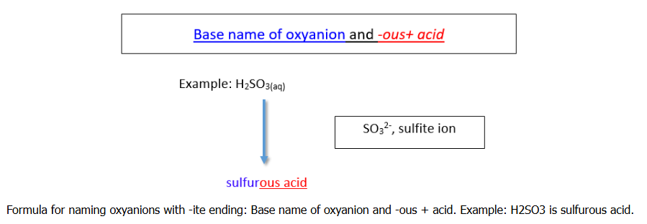
Acid Naming: Oxyacids
An oxyacid consists of hydrogen, oxygen, and a 3rd element (typically non-metal)
If the polyatomic anion has an –ite ending (SO₃²⁻ = sulfite), then the acid name will be
oxyanion base name + -ous acid
Thus H₂SO₃ → sulfurous acid

Slide 49
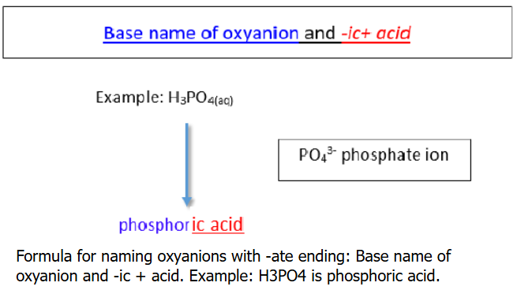
Acid Naming: Oxyacids
If the polyatomic anion has an –ate ending (SO₄²⁻ = sulfate, PO₄³⁻ = phosphate), then the acid name will be:
oxyanion base name + -ic acid
Thus H₂SO₄ → sulfuric acid H₃PO₄ → phosphoric acid

Slide 50
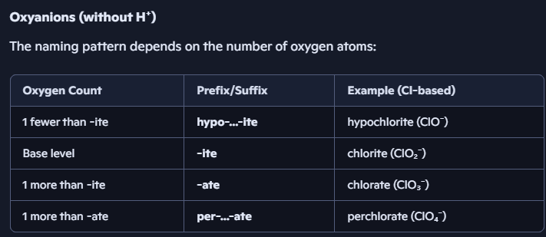
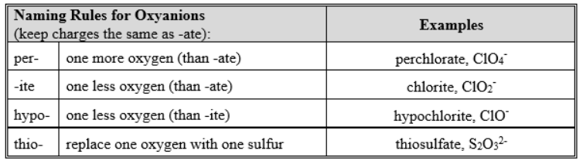
Naming Oxyanions
Without the H⁺ (H⁺ makes an acid an acid)

Slide 51
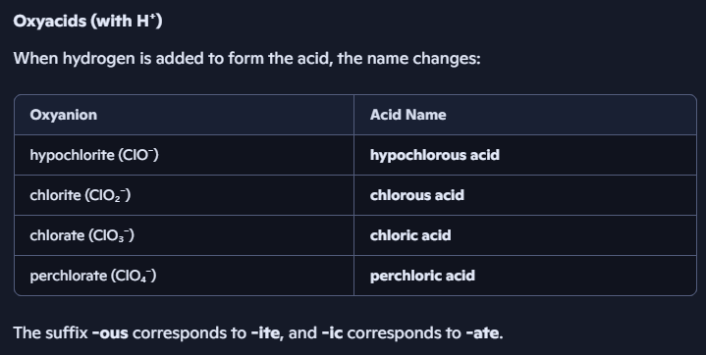
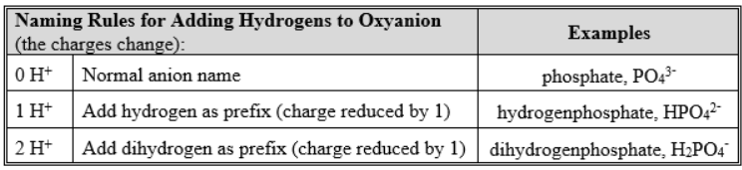
Naming Oxyacids

Slide 52
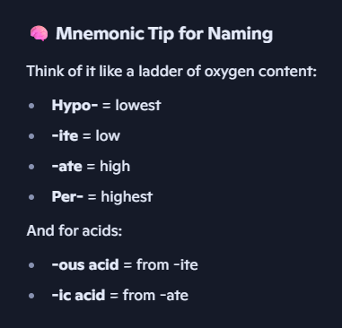
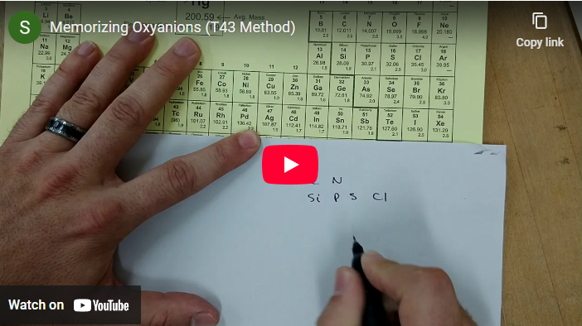
Naming Tips/Mnemonics
https://youtu.be/ijSk_7ukv10

Slide 53
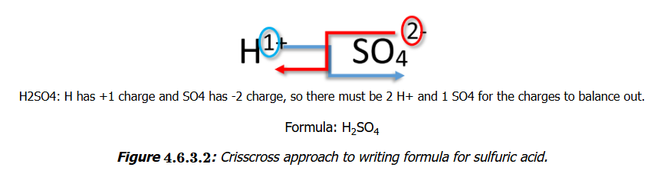
Formula Determination
The crisscross method that was used to determine the subscripts (indicating atom numbers) for compounds of metal cations and nonmetal ions can be used also to determine the formula for protic acids
You should know sulfate ion (SO₄²⁻) is a 2- anion. Knowing that, you can determine how many protons (H⁺ atoms) are needed to balance that charge of the ion

Slide 54
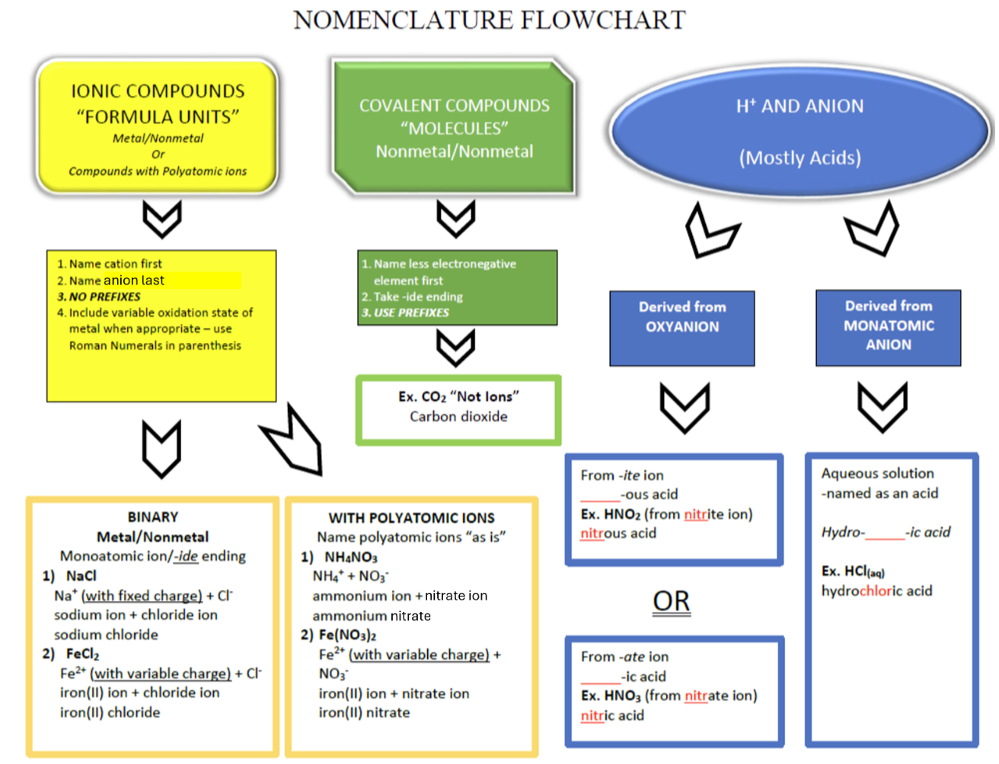
Tying It Together

